Slide 1
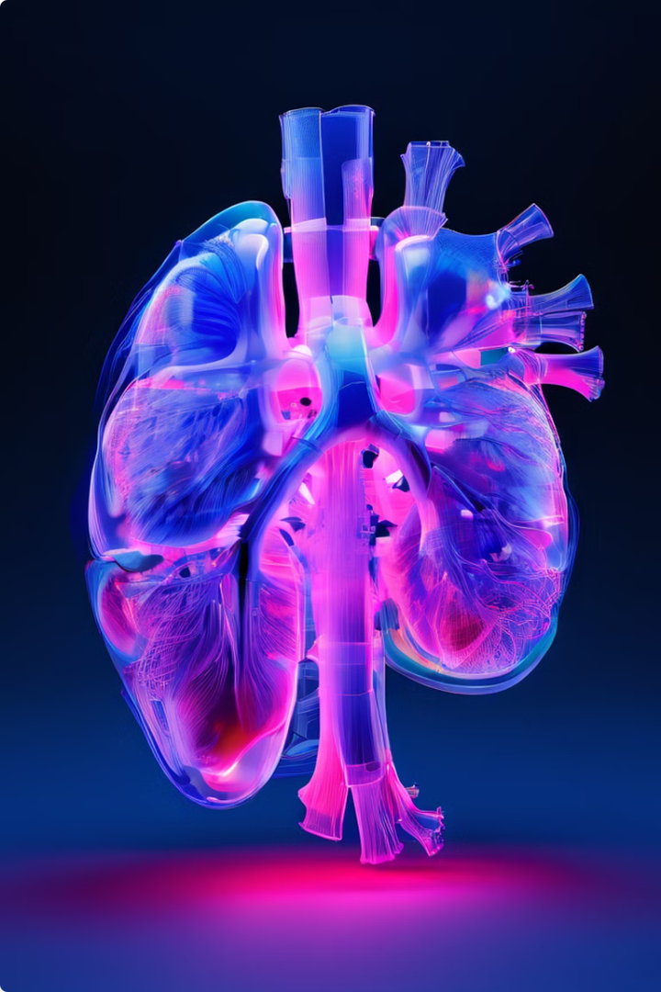

CT Scan Lung Cancer Classification
Lung cancer is a major global health issue, with early detection and classification being key to effective treatment. CT scans are commonly used for diagnosis, but human interpretation can miss subtle signs of early-stage cancer. Deep learning models offer a promising solution by recognizing intricate patterns and subtle abnormalities that are often overlooked. These models also automatically learn relevant features from data, eliminating the need for complex manual feature engineering, making them particularly useful in medical imaging.
In this, we use a dataset containing CT scan images of lungs categorized into four classes: normal, squamous cell carcinoma, adenocarcinoma, and large cell carcinoma.
by SAWAIRA IQBAL

Slide 2
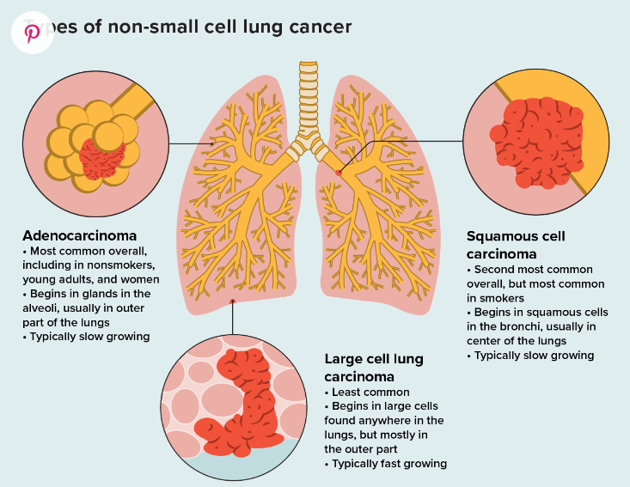

Slide 3
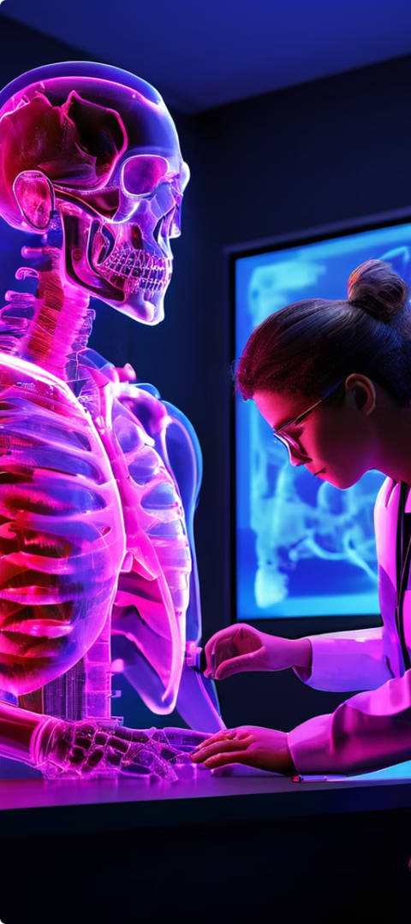
The Significance of Early Detection
1
Improved Outcomes
2
Role of Imaging
Early detection of lung cancer dramatically increases the chances of successful treatment and long-term survival. Catching the disease in its early stages can make a life-saving difference.
CT scans have become a crucial tool in the early diagnosis of lung cancer, providing detailed images that can reveal even the smallest abnormalities in the lungs.
3
Limitations of Current Methods
Traditional diagnostic methods, such as physical exams and biopsies, can be limited in accuracy, accessibility, and cost-effectiveness, highlighting the need for innovative solutions.

Slide 4
Model
Leveraging AI for Improved Diagnostics
Data Collection
Preprocessing Techniques
Project Objectives
The primary goal of this project is to develop a deep learning model that can enhance the classification accuracy of CT scans for lung cancer, leading to faster and more precise diagnoses.
The project utilizes a comprehensive dataset of CT scan images, encompassing a diverse range of lung conditions. The dataset includes over 10,000 high-quality images, ensuring a robust foundation for model training and evaluation.
The CT scan images undergo a rigorous preprocessing phase, including resizing, normalization, and data augmentation. These steps ensure the data is optimized for effective model training and performance.

Slide 5




Overcoming Challenges
Data Imbalance
Computational Limitations
Continuous Improvement
The project faced the challenge of data imbalance, with some lung conditions being underrepresented in the dataset. This was addressed through advanced data sampling techniques to ensure balanced training.
The team is committed to ongoing research and development, exploring ways to further refine the models and expand the project's capabilities to address the evolving needs of lung cancer diagnosis.
The computational resources required for training the deep learning models were significant, necessitating the use of powerful GPUs and efficient training strategies to overcome these limitations.

Slide 6

Cutting-Edge Deep Learning Models
1
Model Selection
The project employs a suite of state-of-the-art deep learning models, including VGG19, ResNet50, DenseNet201, and EfficientNetB4, each chosen for their proven track record in image classification tasks.
2
Training and Tuning
The models undergo rigorous training, with careful attention to hyperparameter optimization through techniques like grid search and random search. This process ensures the models are fine-tuned for maximum performance on the lung cancer classification task.
3
Comparative Analysis
The project conducts a comprehensive analysis of the models' performance, comparing their accuracy, loss, and other key metrics to identify the most effective solution for lung cancer diagnosis.

Slide 7
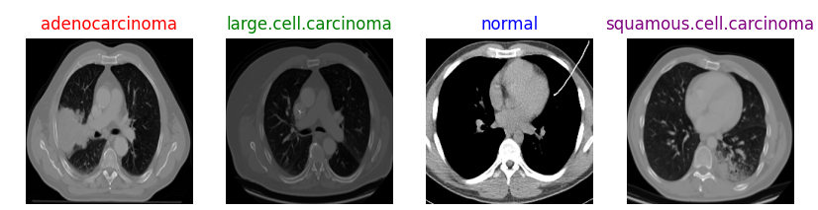
ctscan Dataset of Lung Cancer having 4 Classes with labels

Slide 8
What I am Doing in this project:🔍
Build Model Architecture
Apply Almost 5 to 6 Models(ResNet50,VGG16,ResNet101, VGG19, DenseNet201, EfficientNetB4, MobileNetV2) using Transfer Learning🧠
Select 3 Most Promising Models 🌟
Fine Tuning These Models to Increase Accuracy 📈

Slide 9
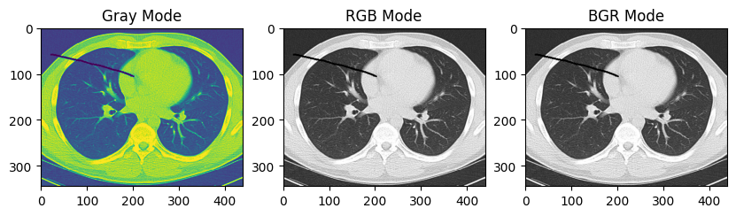
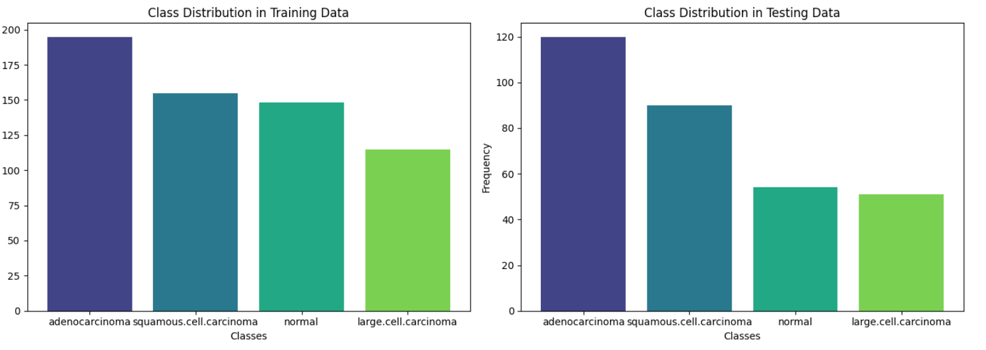
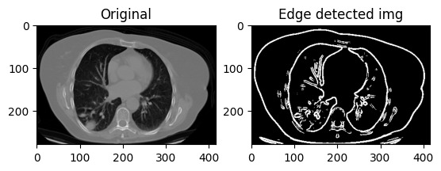
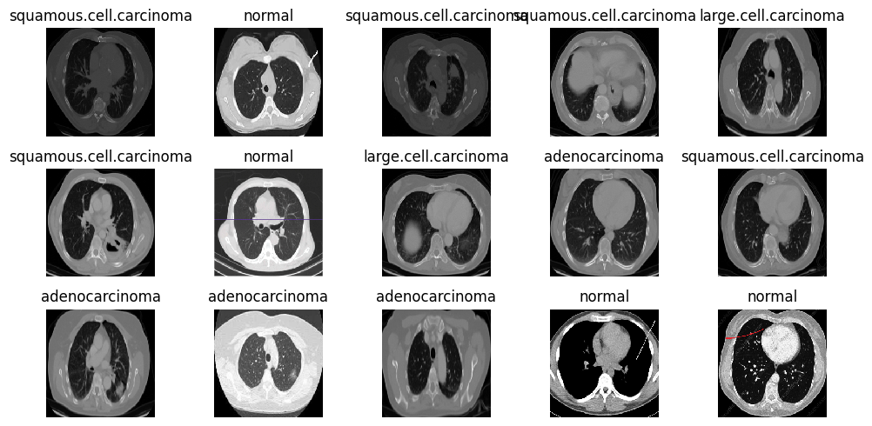
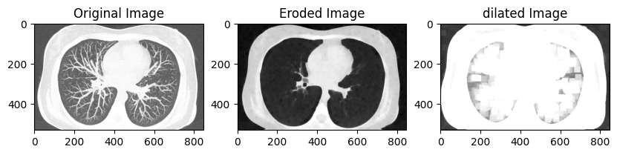
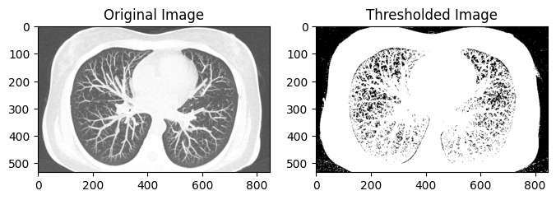
Exploratory Data Analysis

Slide 10
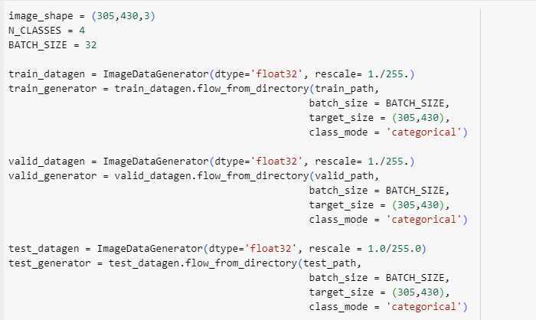
Preprocessing:🔍
ImageDataGenerator Setup:
Configures image data generators for training, validation, and testing datasets.
Normalizes image pixel values to a range of 0 to 1 to ensure consistent feature scale across all input images
Uniform Image Scaling:
Facilitates efficient gradient descent by standardizing the scale of input features, leading to faster convergence.
Image Resizing and Batch Processing:
Resizes incoming images to (305, 430, 3) to match the expected input shape of the neural network.
Processes images in batches of 32, optimizing memory usage and computational speed during training.

Slide 11
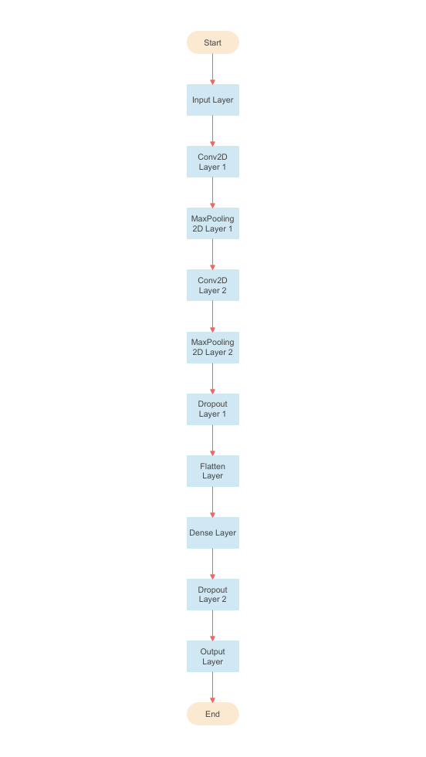
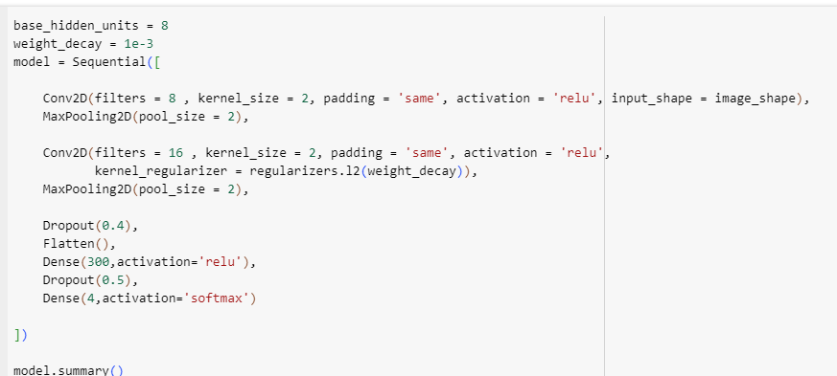
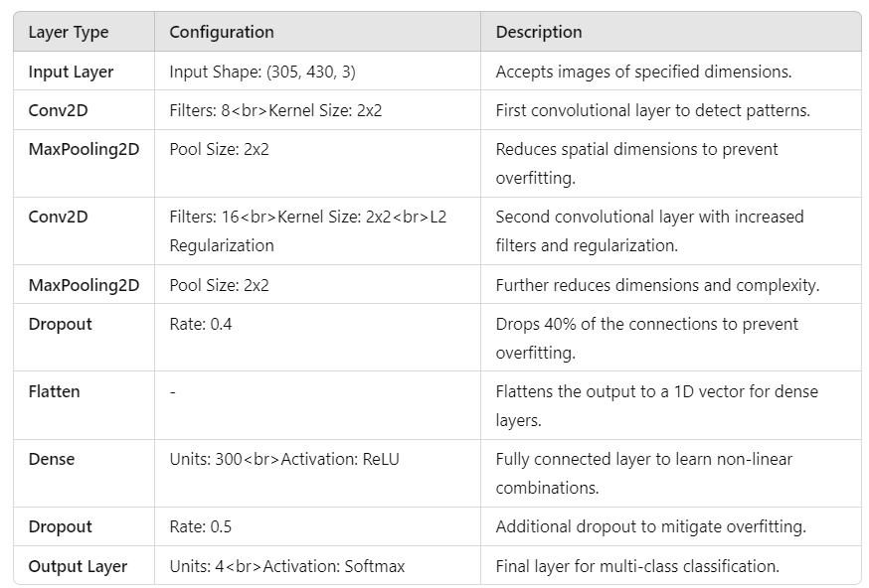
CNN Model Architecture

Slide 12
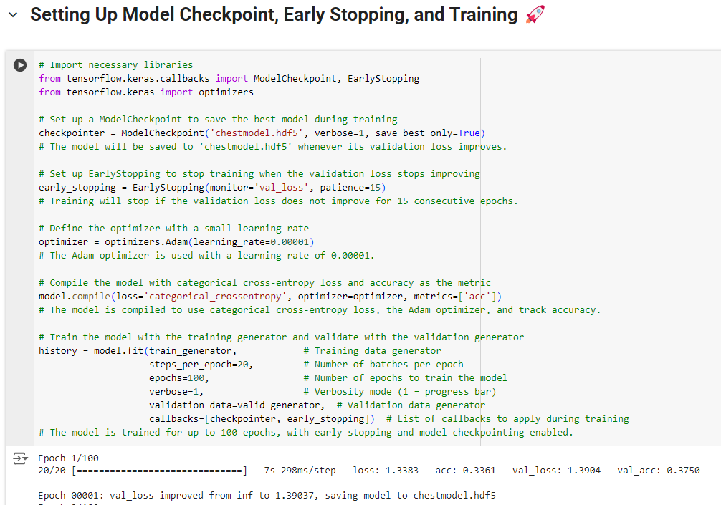
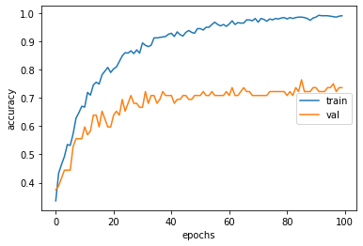
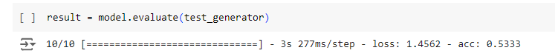
verbose=0: No output will be shown.
verbose=1: Shows a progress bar with the training progress for each epoch.
verbose=2: Prints the loss and accuracy for each epoch on separate lines.

Slide 13
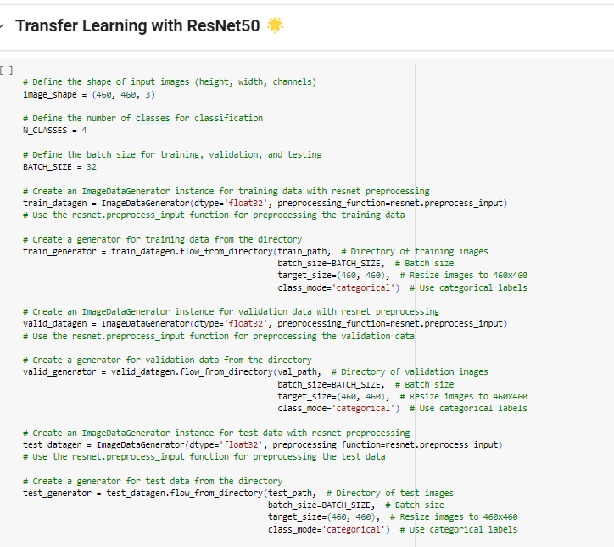
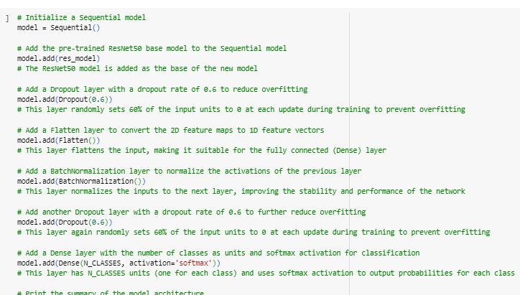
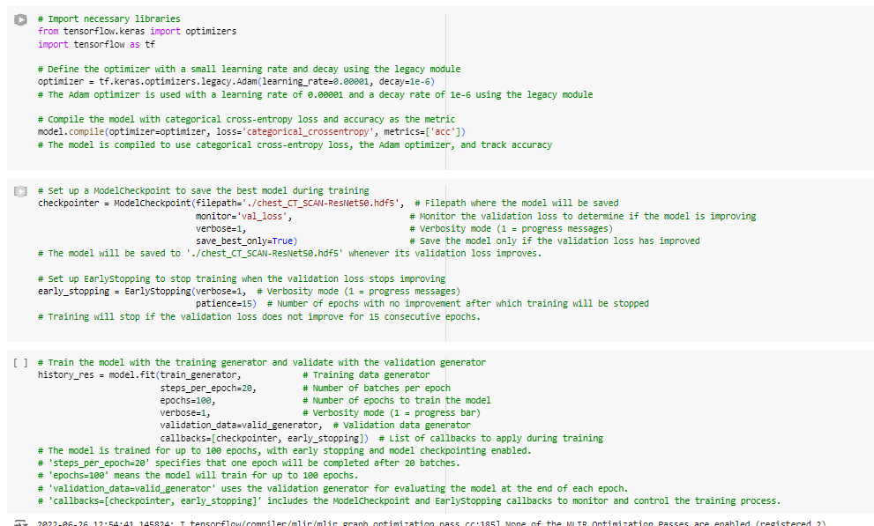
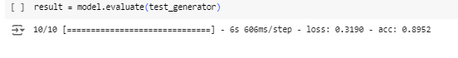

Slide 14
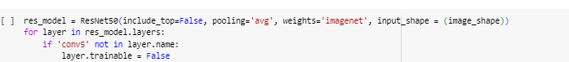
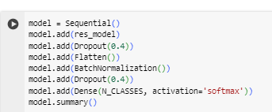
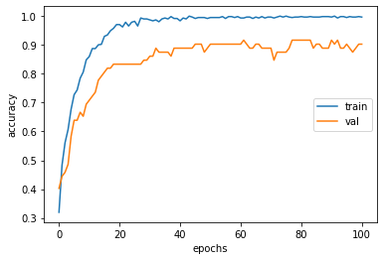
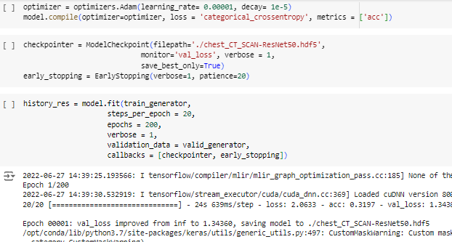

Hyperparameter Tunning On ResNet50:

Slide 15

Achieving Exceptional Accuracy
Initial Model Accuracies
Tuning for Optimization
Before hyperparameter tuning, the models achieved the following test accuracies: ResNet50 (86%), DenseNet201 (88%), and EfficientNetB4 (90%).
Through rigorous hyperparameter tuning, the models' performance was further enhanced, with the best-performing model achieving a remarkable test accuracy of 94.5%.
Clinical Implications
The exceptional accuracy of the deep learning model has the potential to revolutionize lung cancer diagnosis, enabling faster, more reliable, and cost-effective screening, ultimately leading to improved patient outcomes.

Slide 16
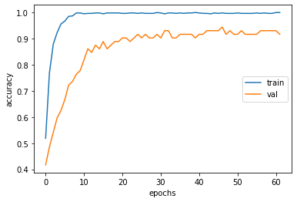
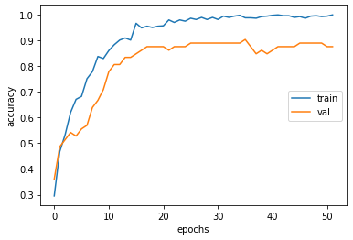
Plots after Hyperparameter Tunning of 3 most promising Models:
ResNet50
DenseNet201
EfficientNetB4

Slide 17
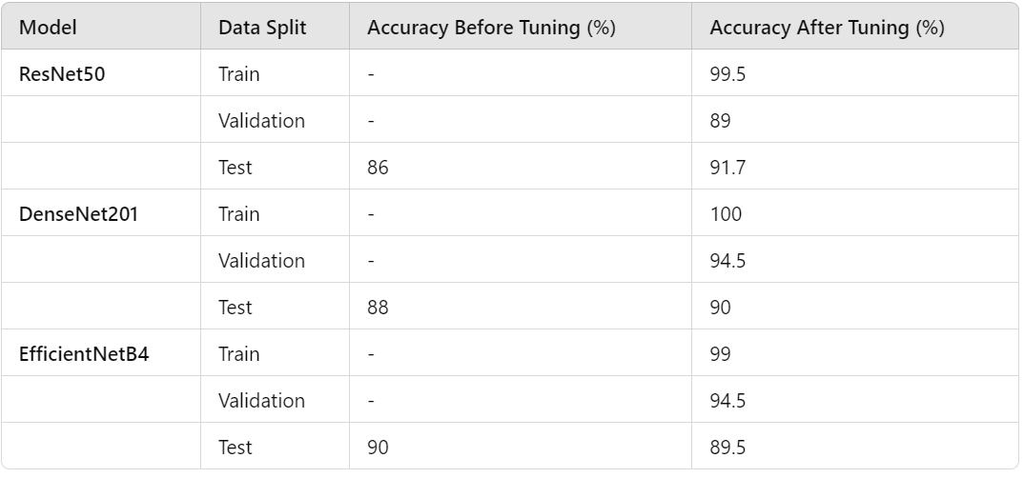
CT Scan Imaging in Lung Cancer Classification

Slide 18
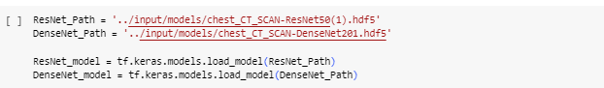
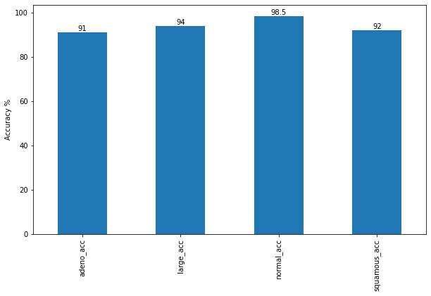
From results we can see that using both models (ResNet + DenseNet) is more accurate rather than using only one of them

Slide 19
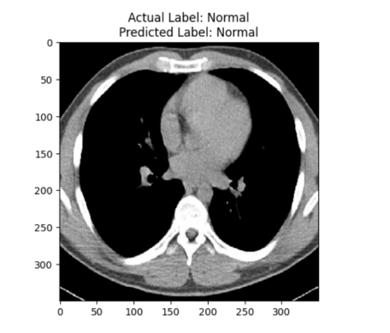
Prediction using Best Model:

Slide 20



The Path Forward
Expanded Datasets
Interdisciplinary Collaboration
Clinical Integration
Acquiring larger and more diverse datasets will enable the models to learn more comprehensive representations of lung conditions, further enhancing their diagnostic capabilities.
Seamless integration of the deep learning models into clinical workflows will ensure the widespread adoption and real-world impact of this transformative technology.
Fostering collaborations between medical professionals, computer scientists, and researchers will drive continuous advancements in the field of AI-powered lung cancer diagnosis.

Slide 21
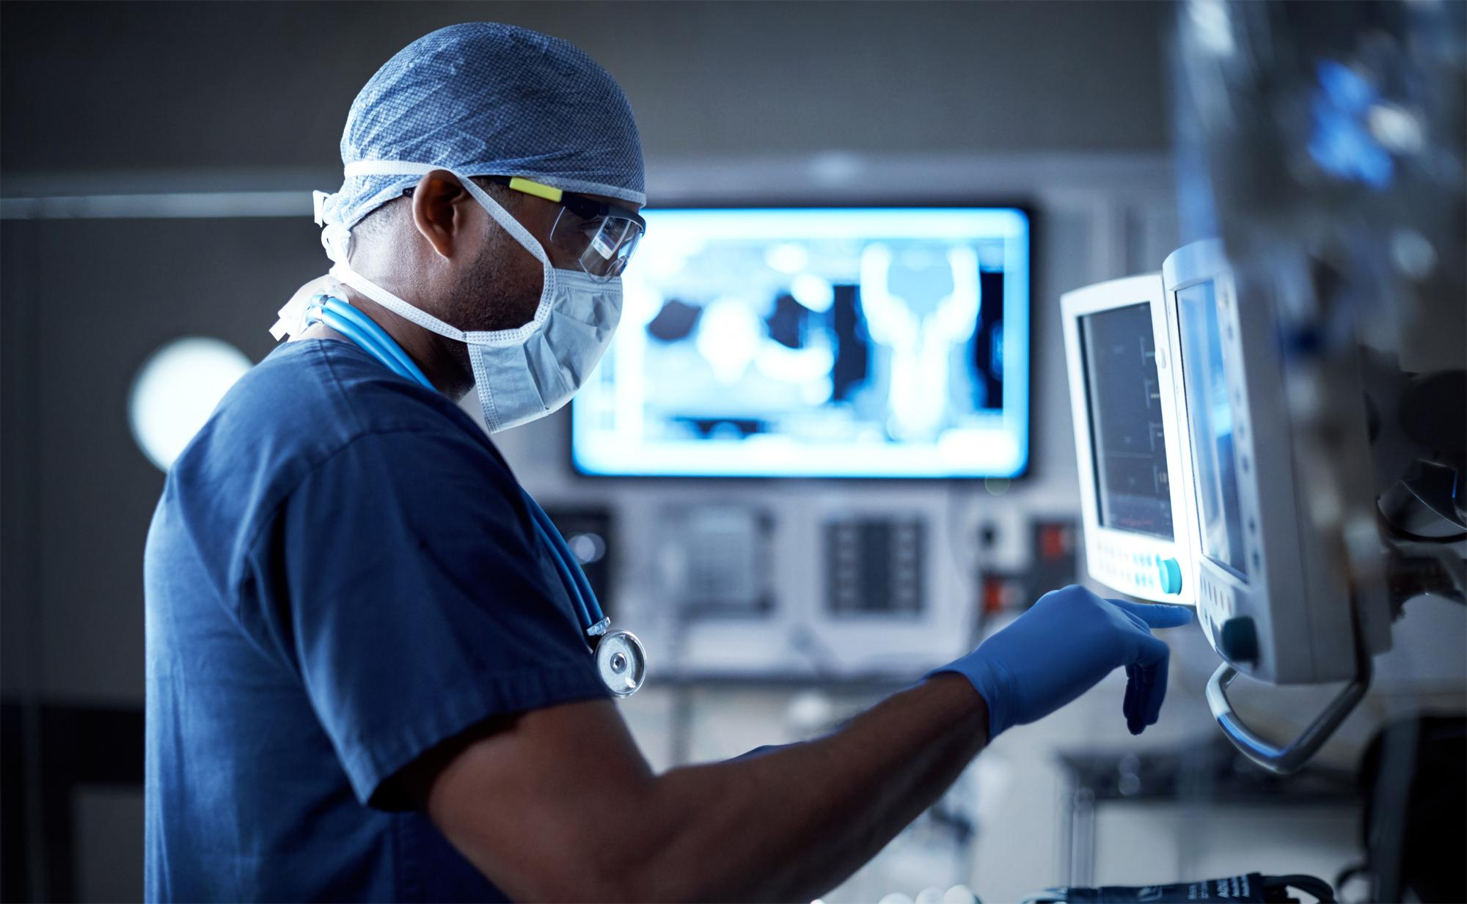
Conclusion
This project has demonstrated the immense potential of deep learning in revolutionizing lung cancer diagnosis. By leveraging the power of CT scan imaging and cutting-edge AI models, we have achieved exceptional classification accuracy, paving the way for more reliable, efficient, and accessible lung cancer screening. As we continue to refine and expand this technology, we are confident that it will have a profound impact on patient outcomes and the global fight against this devastating disease.

